Slide 1
Creating art through the lens of GAN
DATA255: Project Presentation- Group 3
Guided by: Prof. Simon Shim PhD

Slide 2
Our Team
Huan Nguyen
Manisha Paliwal
Madhur Parakh
Smit Vinod Savla
Shounak Upadhyay

Slide 3
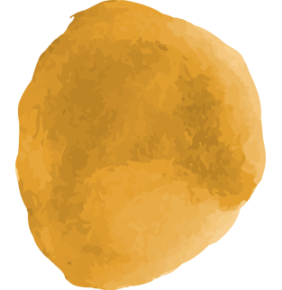
Contents
Introduction
Related Work
Application
Data Engineering
Modelling
Conclusion
Motivation, Originality & Background
Literature Survey of existing solutions
Real world uses
Data Pre-processing, Visualization & EDA, Augmentation,Feature Engineering
ML/DL model architecture, results & comparison
Summary and future scope

Slide 4
Introduction
Boom in usage of GAN, made image generation and translation models very popular.
In our project, we are creating multiple CycleGAN models for style transfer by modifying base Cycle GAN with Pix2Pix,DCGAN & Residual block architectures

Slide 5
Image Generation
Image Translation
Style Transfer
when we create a fake image from random inputs.
when we convert one image to another.
when we do image translation such that a desired style or pattern is achieved in the outcome.

Slide 6
Motivation
Below mentioned points are the motivation behind this project:
GAN is a new interesting concept and we wanted to explore and experiment with it
Kaggle Competition participation
Creating models which can act as filters which are popular on social media.

Slide 7
Originality
Model Architecture
Model Comparison
All the models used in this project have original architecture. Dense, PIX2PIX & Improved version are added to create completely unique models.
We have used 4 models for Monet style transfer on images and compared them on the basis of results obtained.

Slide 8
Related Works
Author | Model | Description | Year | Ref.
Karol Gregor et. al (DeepMind) | Deep Recurrent Attentive Writer (DRAW) | Sequential image generation using recurrent NN. Good for generating images similar to MNIST or SVHN. | 2015 | [1]
C. Zhang et. al | StackGAN++, BDA-CE, Neural Network | AI Painting: Four step process with GAN for image generation, Autoencoder and NN for style transfer. | 2018 | [2]
Han Meng et. al | GAN with Linear and Convolutional layers | Performance on MNIST data for image generation is compared for the two models. | 2021 | [3]
Colin Chen et. al | Cycle GAN | Style transfer of human face to cartoon using Cycle-GAN and hyperparameter tuning. | 2022 | [4]

Slide 9
Applications
Filter
Paintings
Model
The model generated can be used on any platform to apply a monet style filter to image data.
Even though the artist has passed, we can use the models in this project to generate new paintings in Monet “je ne sais quoi”
All the models have a completely unique architecture and can be used in any other domain to generate good results.

Slide 10
Proposed Solution

Slide 11
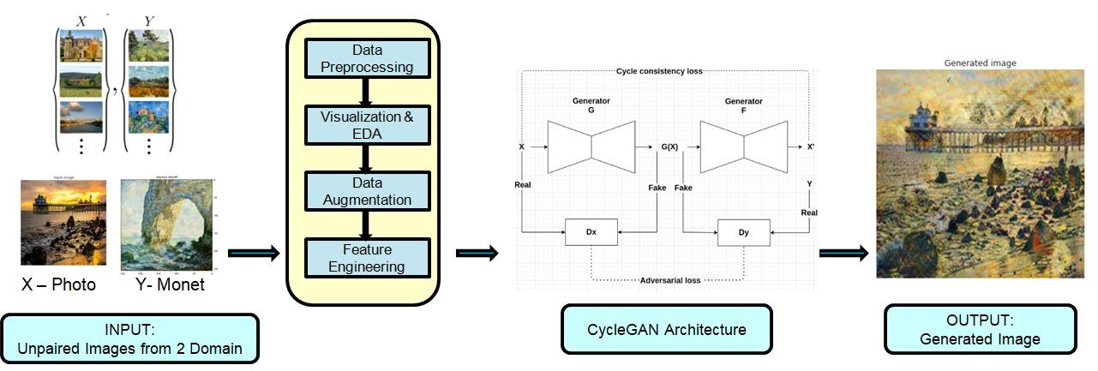
System Architecture
High Level System Design Overview

Slide 12
Data Pre-processing
Data Collection
The data is taken from kaggle competition ‘I’m Something of a Painter Myself’
Dataset Statistics & Attributes
300 High resolution Monet Images in jpg format
7038 High Resolution Photo Images in jpg format
Data Cleaning and Validation
Originally images are of high resolution and good quality
Images Resized to (3,256,256)
Images Normalized with mean=0.5 & std=0.5
DataLoader
To process data into model without memory issues, images are divided into multiple batches with use of DataLoader library with batch size as below for train and test
batch_size_train = 8
batch_size_test=16

Slide 13
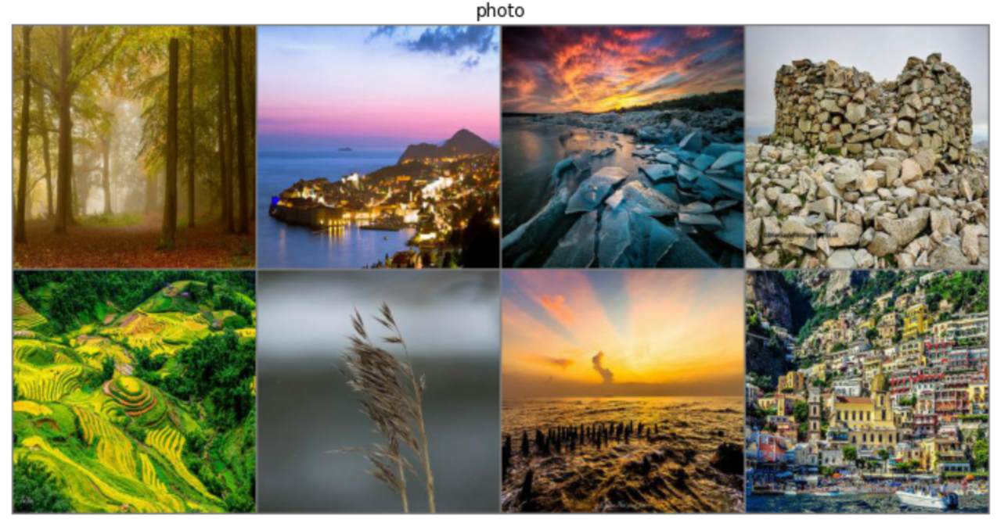
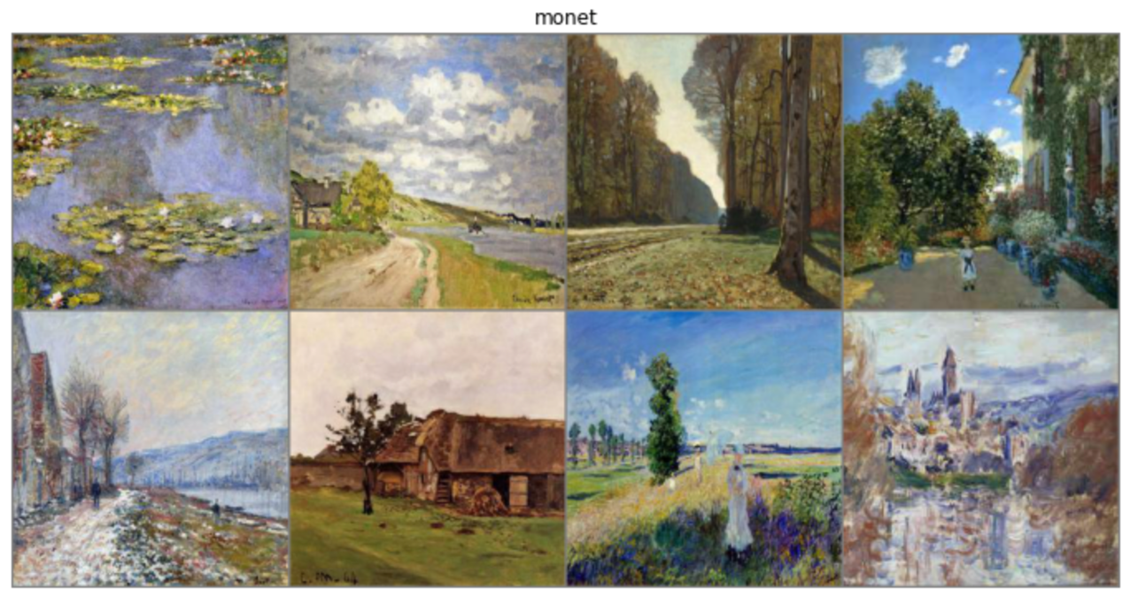
Data Visualization
Domain A : Photo Images
Domain B : Monet Images

Slide 14
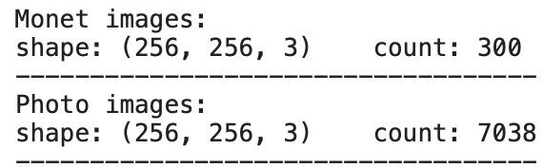
EDA
Total Images in Each Domain

Slide 15
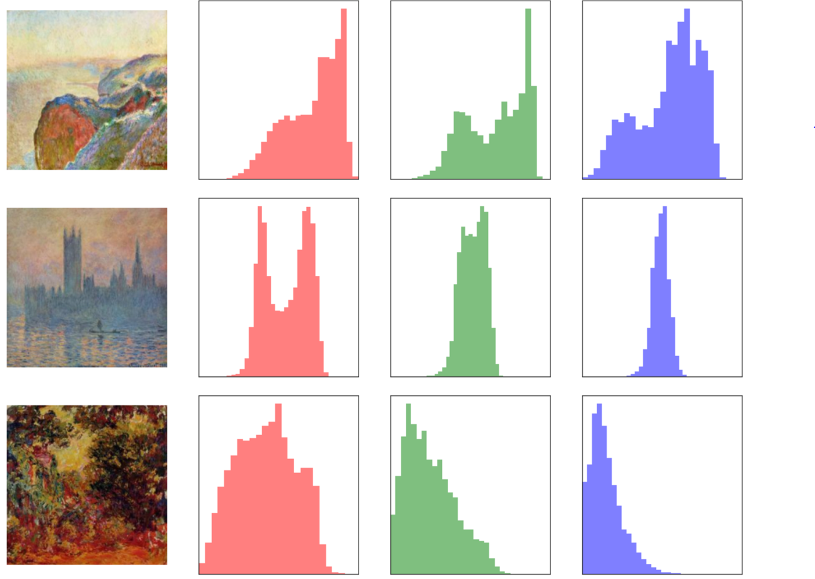
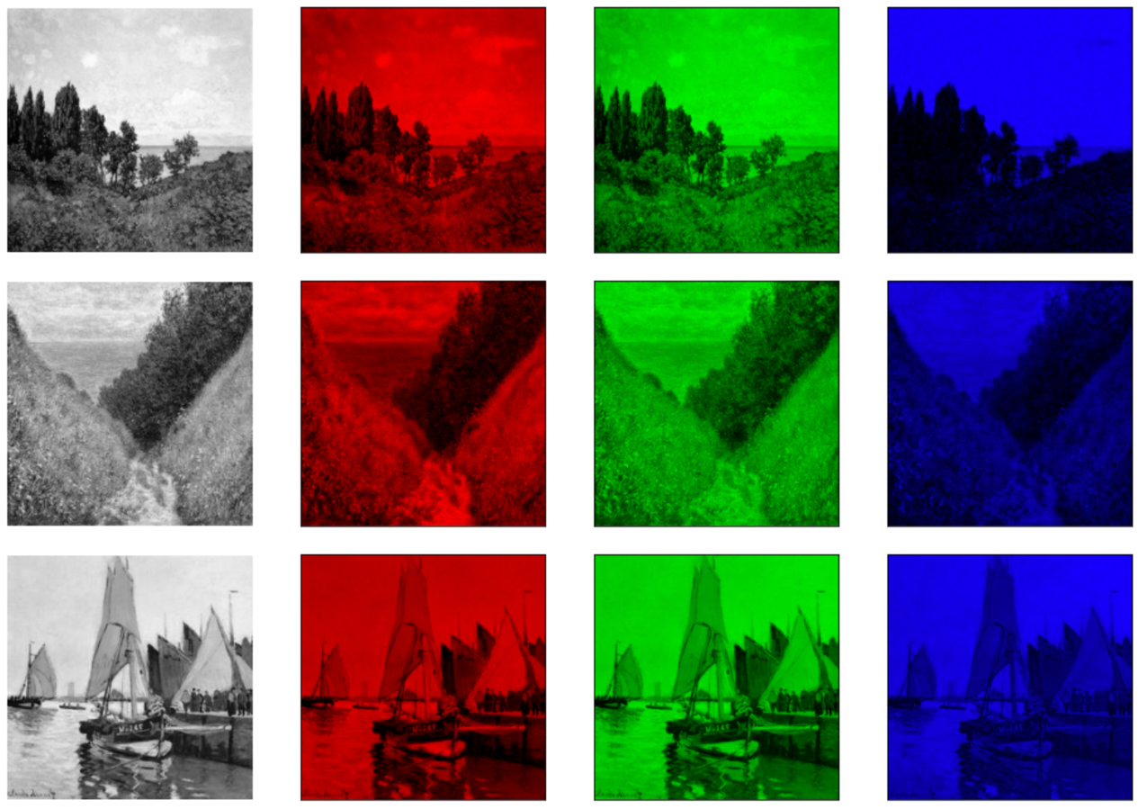
EDA
Histogram to show image channel distribution
RGB Channel of Images

Slide 16
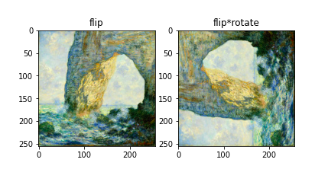
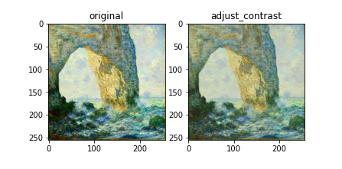
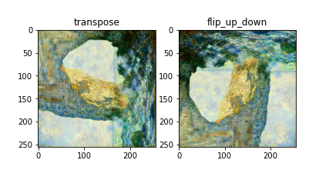
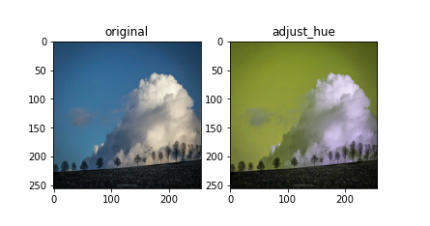
Data Augmentation

Slide 17
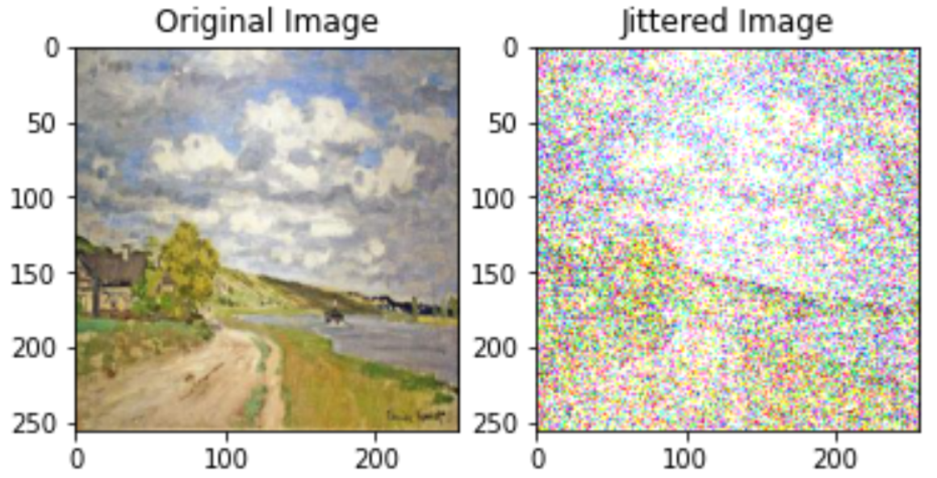
Data Augmentation

Slide 18
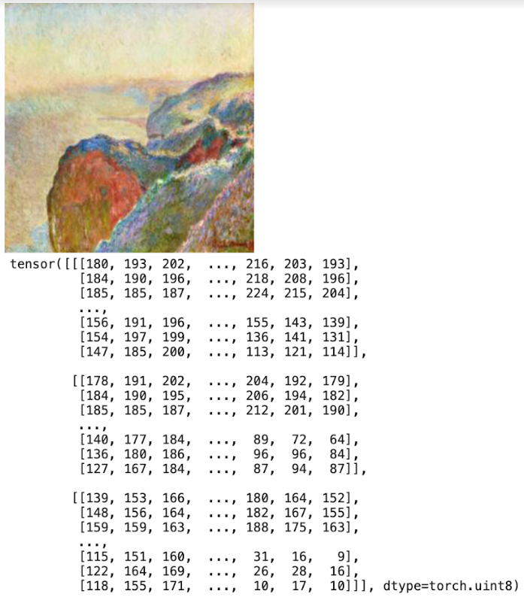
Feature Engineering
Converted Image with specific (Height x Width x Channel) in the range [0, 255] to a torch.FloatTensor of shape (Channel x Height x Width)
The Image belongs to at least one of the RGB mode
Tensors are returned with scaling to further use for model training

Slide 19
Models & Their Performances

Slide 20
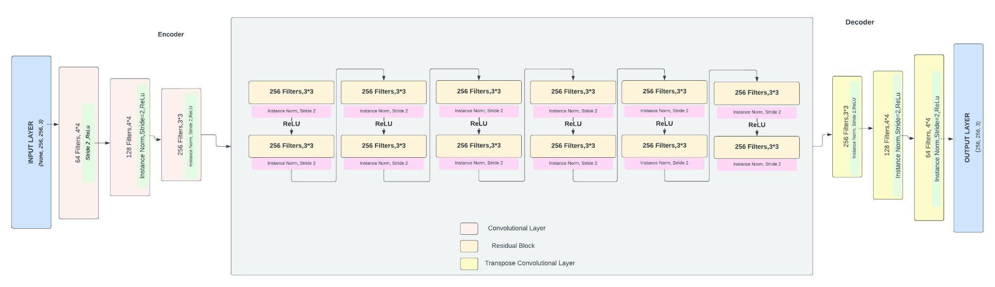
Base Model Cycle GAN
Generator

Slide 21
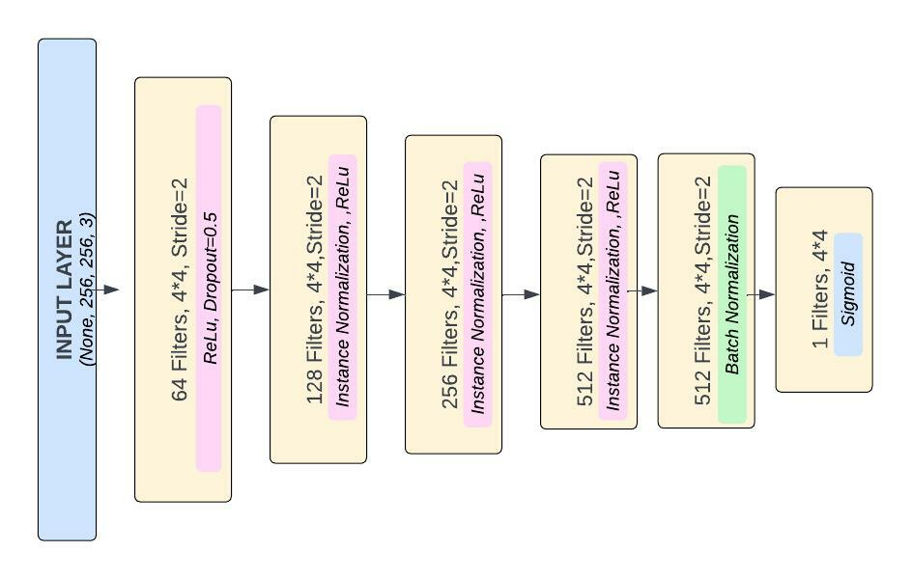
Base Model Cycle GAN
Discriminator

Slide 22
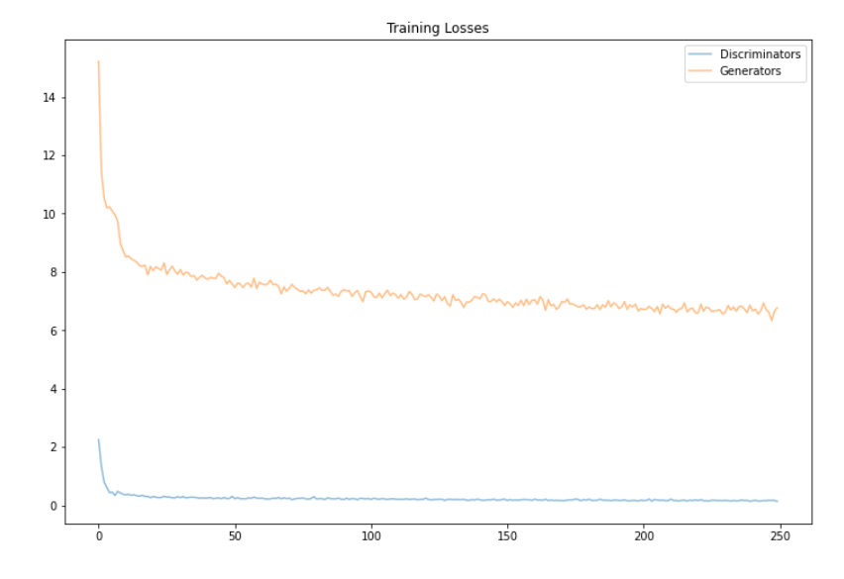
Performance Results
Hyperparameters
Activation Function: ReLu
Learning Rate: 0.0002
Optimizer: Adam
Residual Blocks : 6
Epochs: 250
Performance & Evaluation
Generator Loss: 250 epochs is 6.76. The loss at the first epoch was 15.22, which decreased to 6.76
Discriminator Loss: Initially was 2.25 and after training for 250 epoch was 0.1365

Slide 23
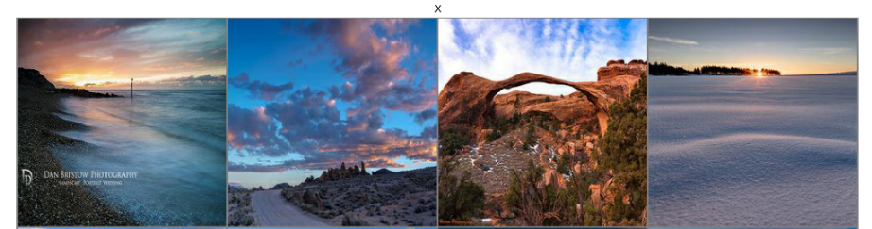
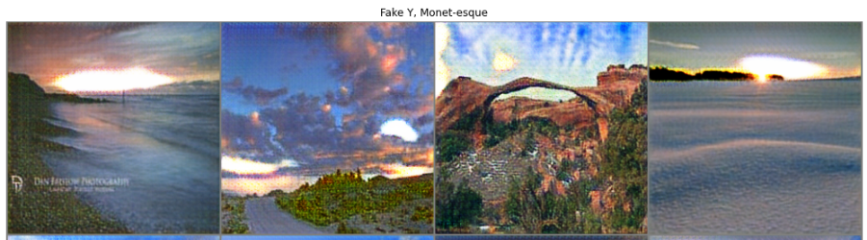
Output Visualization

Slide 24
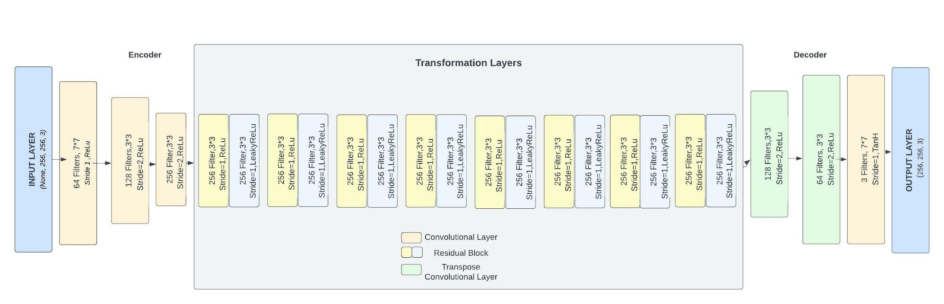
Improved Cycle GAN
Generator

Slide 25
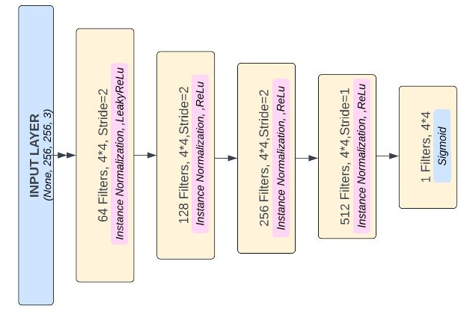
Improved Cycle GAN
Discriminator

Slide 26
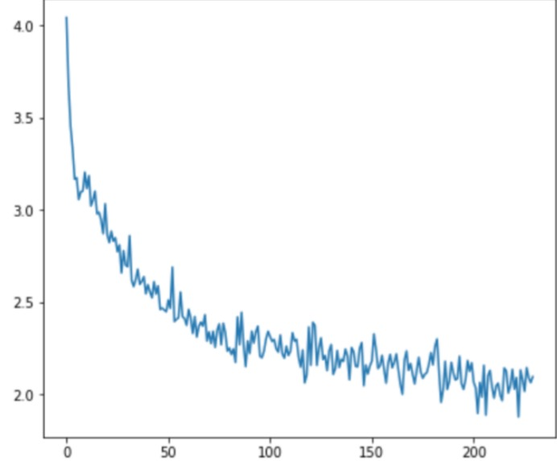
Performance Results
Hyperparameters
Activation Function: ReLu
Leaky ReLu in Residual Block
Learning Rate: 0.0002
Optimizer: Adam
Residual Blocks : 8
Epochs: 200
Performance & Evaluation
Generator Loss: 200 epochs is 2.0634. The loss at the first epoch was 4.178, which decreased to 1.98
Discriminator Loss: Initially was 0.5585 and after training for 200 epoch was 0.4799

Slide 27
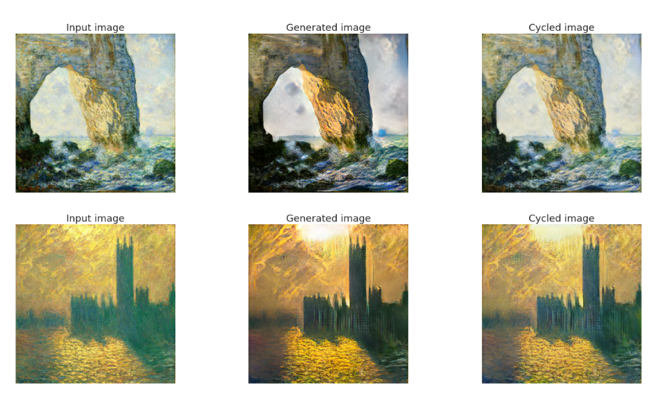
Output Visualizations

Slide 28
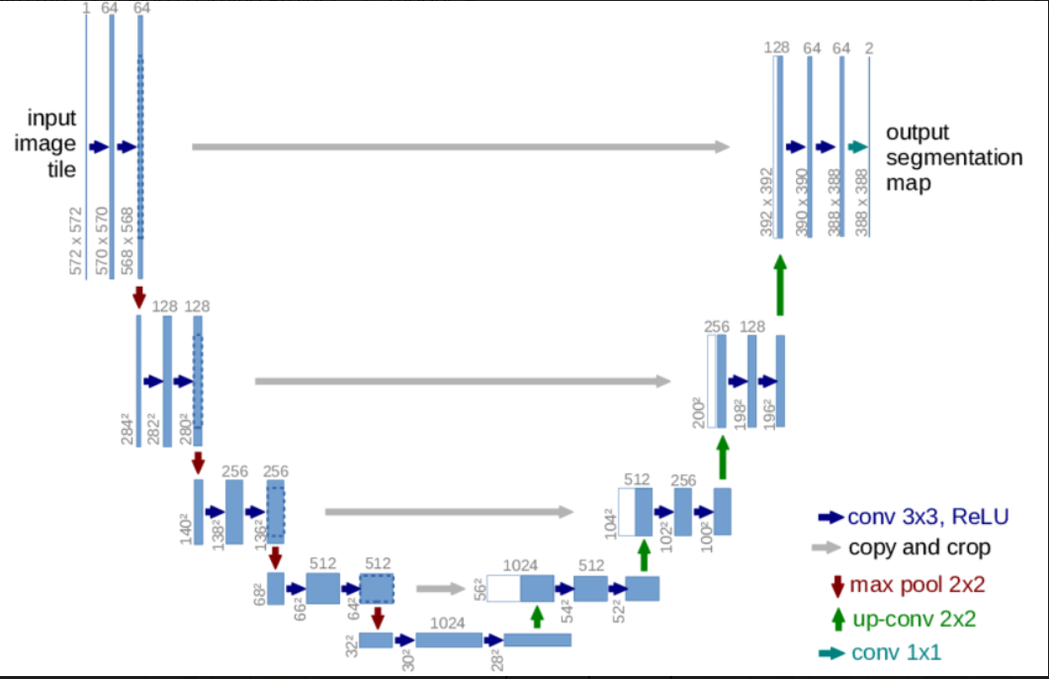
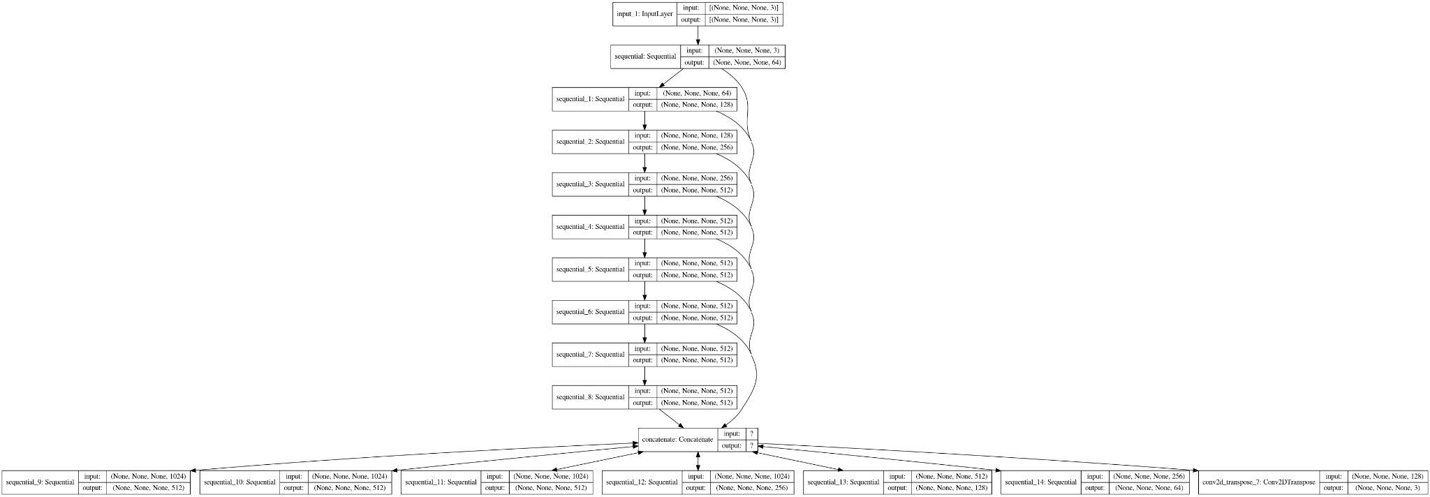
Pix2Pix Based Cycle GAN
Generator

Slide 29
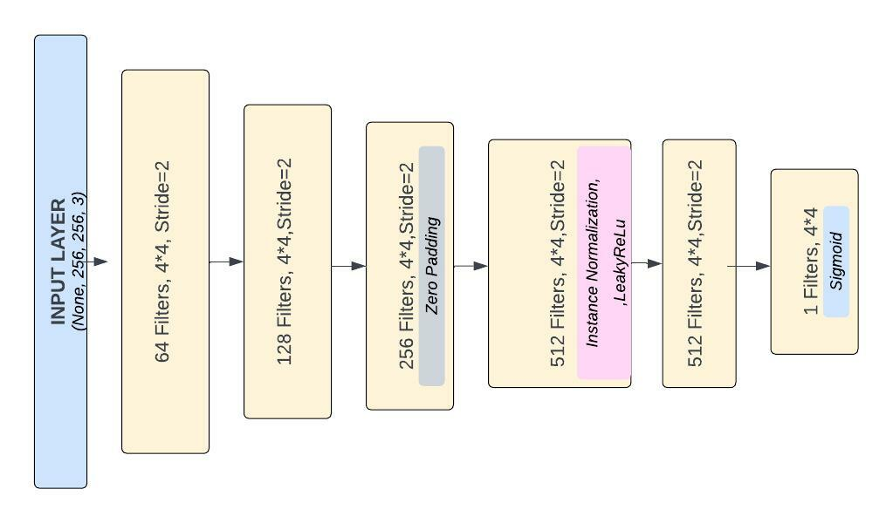
Pix2Pix Based Cycle GAN
Discriminator

Slide 30
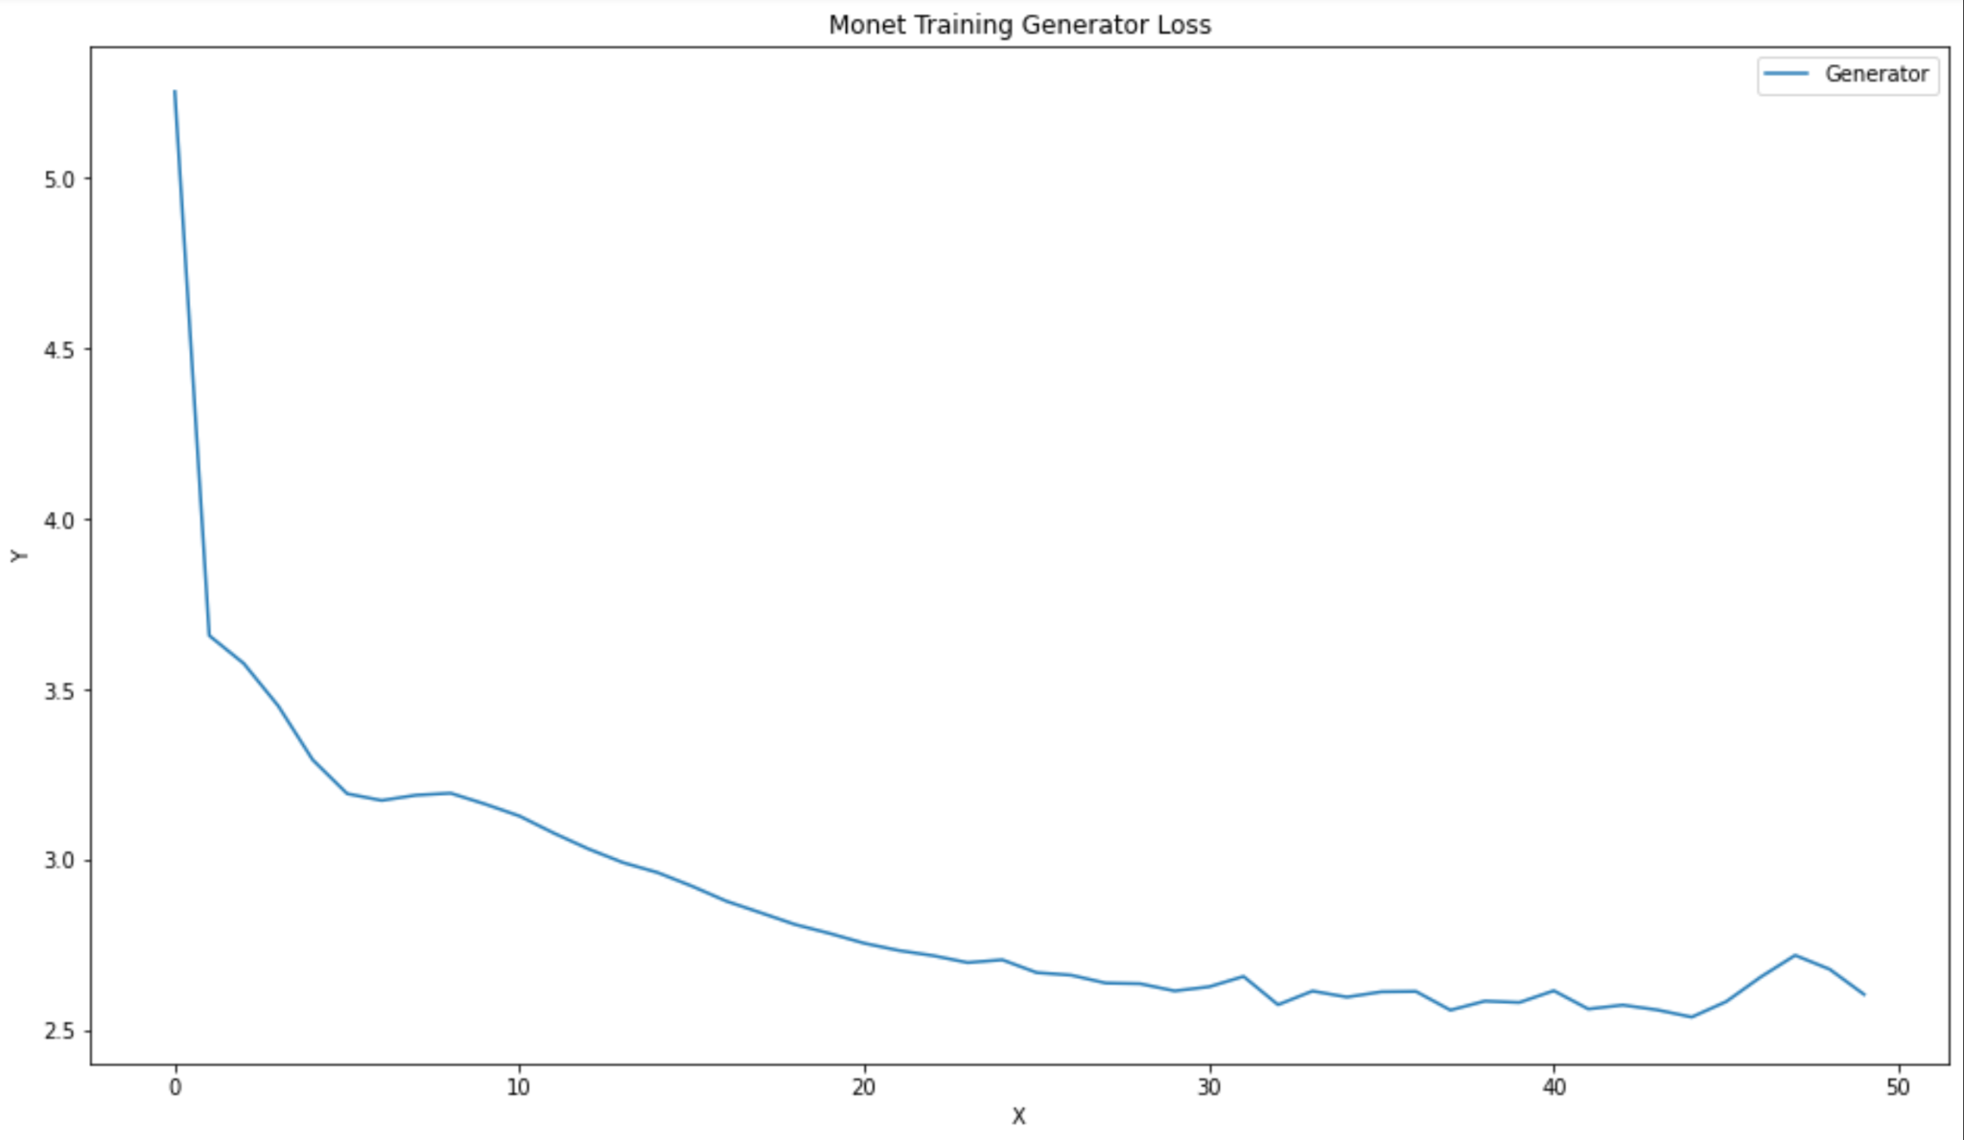
Performance Results
Hyperparameters
Pre-defined architecture from tensorflow
Learning Rate: 0.0002 (both G & D)
Optimizer: Adam (beta_1 = 0.5)
Epochs: 50
Performance & Evaluation
Generator Loss: 6.25 to 2.60 at 50 epochs.
Discriminator Loss: 0.26 after 50 epochs

Slide 31
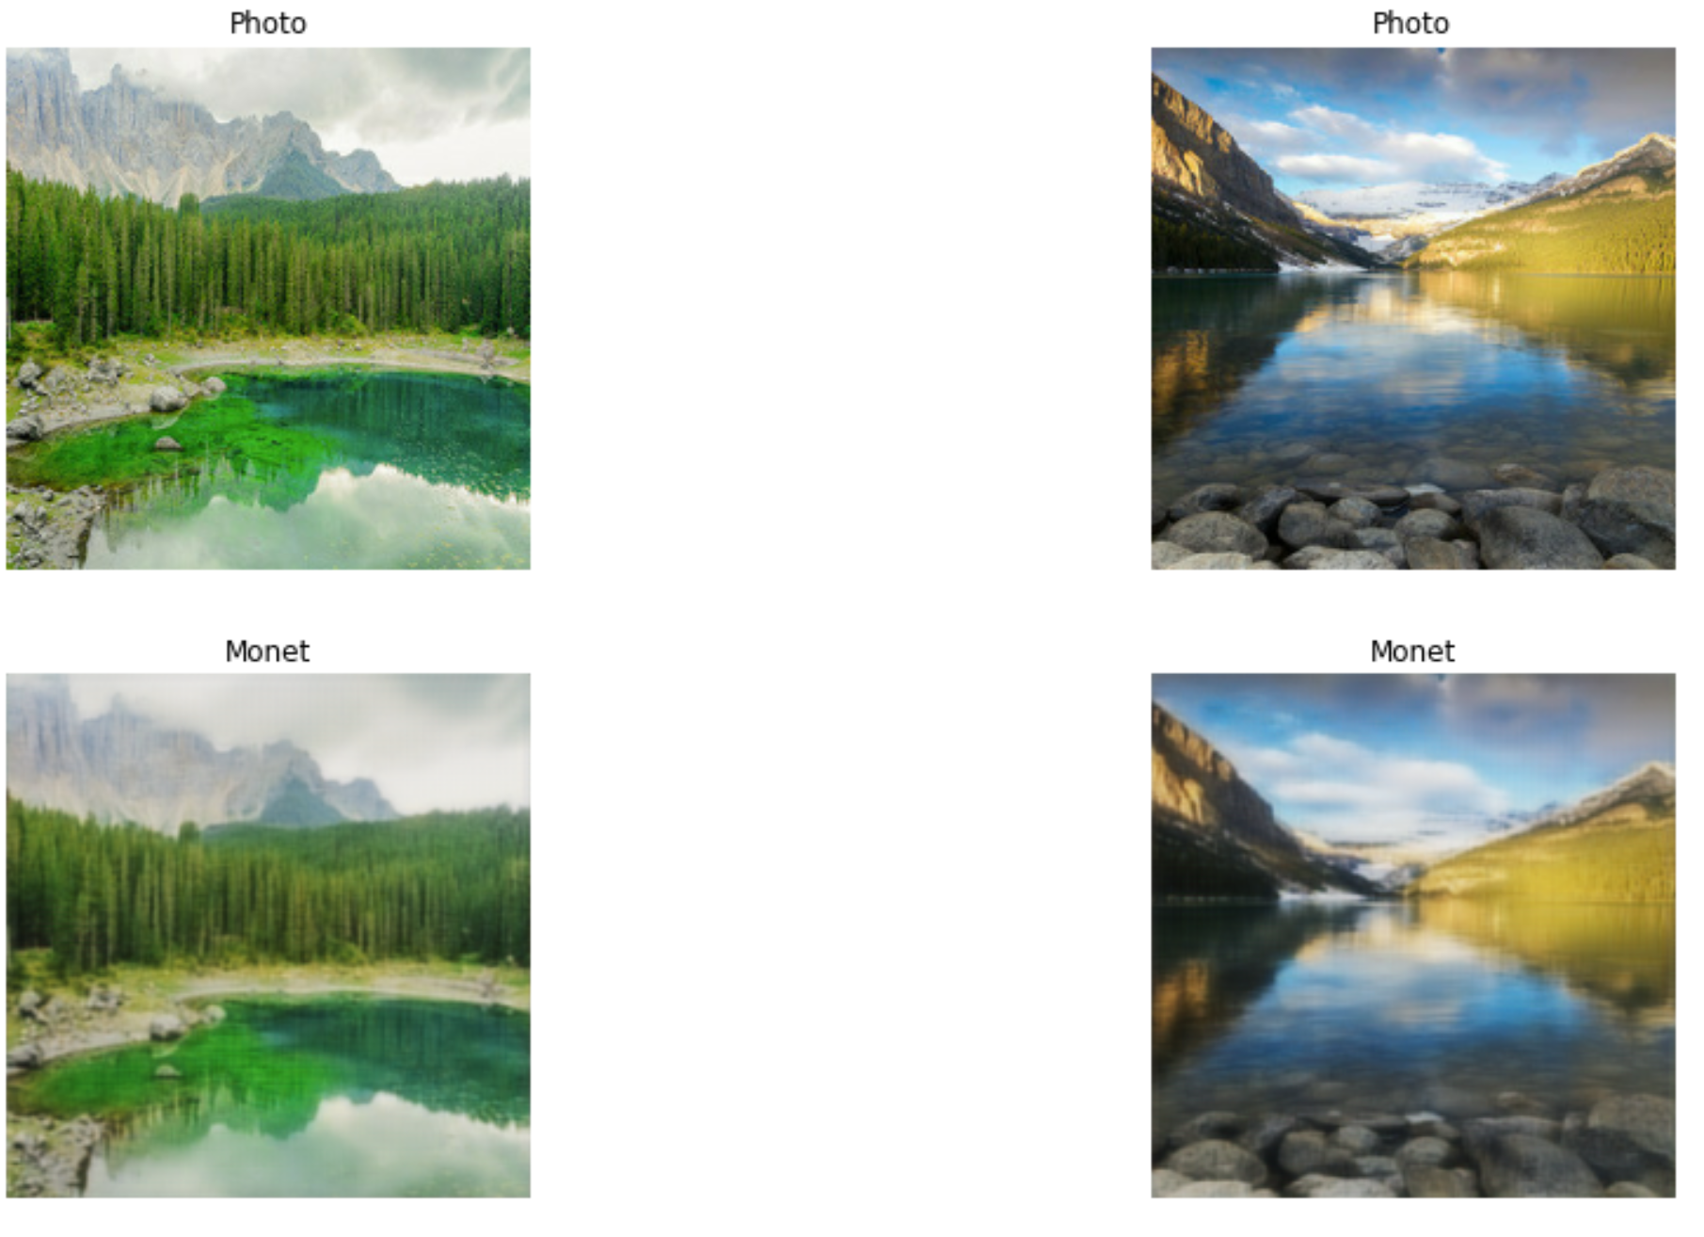
Output Visualizations

Slide 32
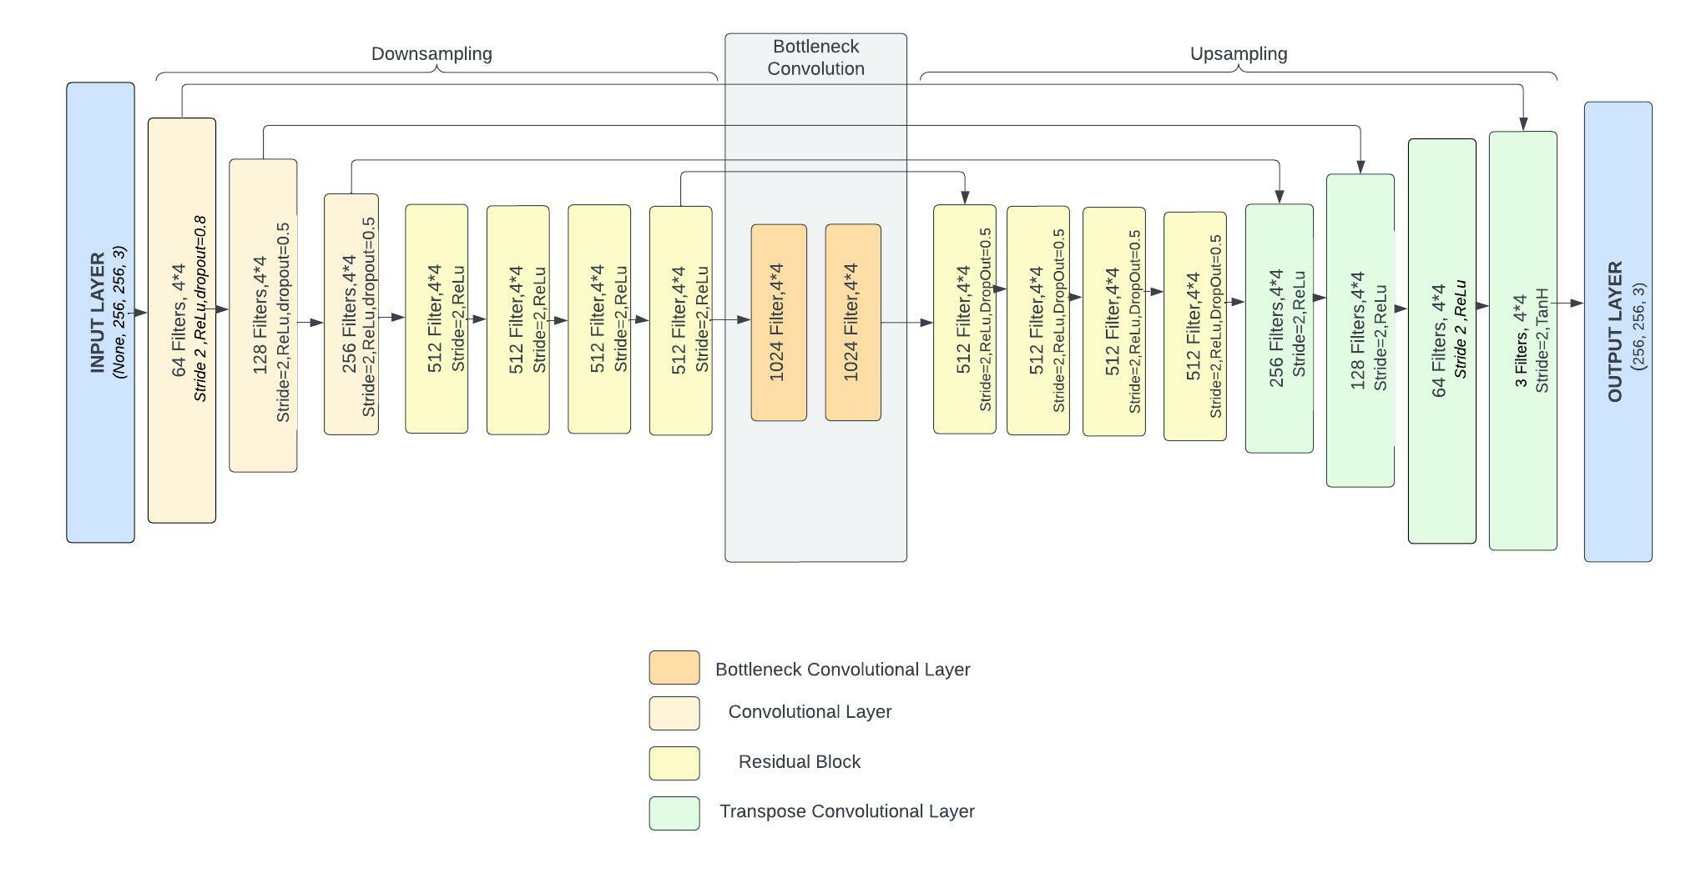
DCGAN Based Cycle GAN
Generator

Slide 33
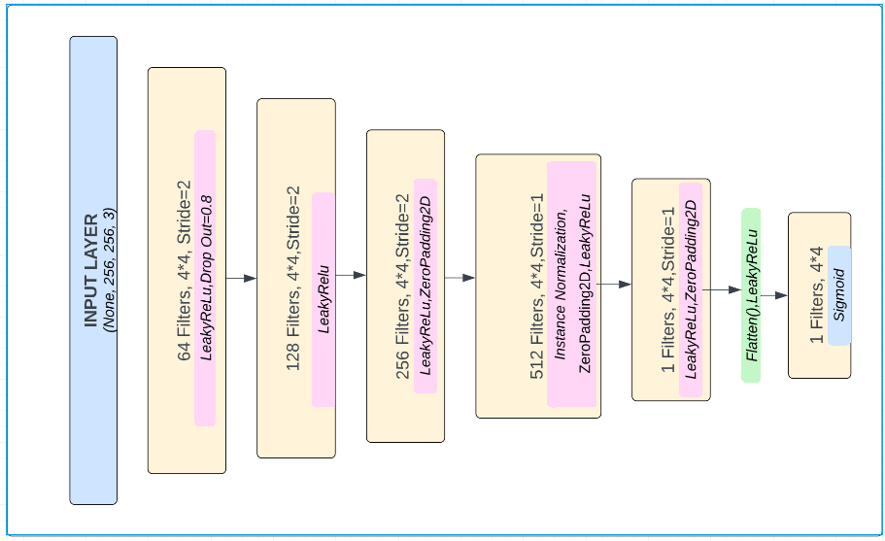
DCGAN Based Cycle GAN
Discriminator

Slide 34
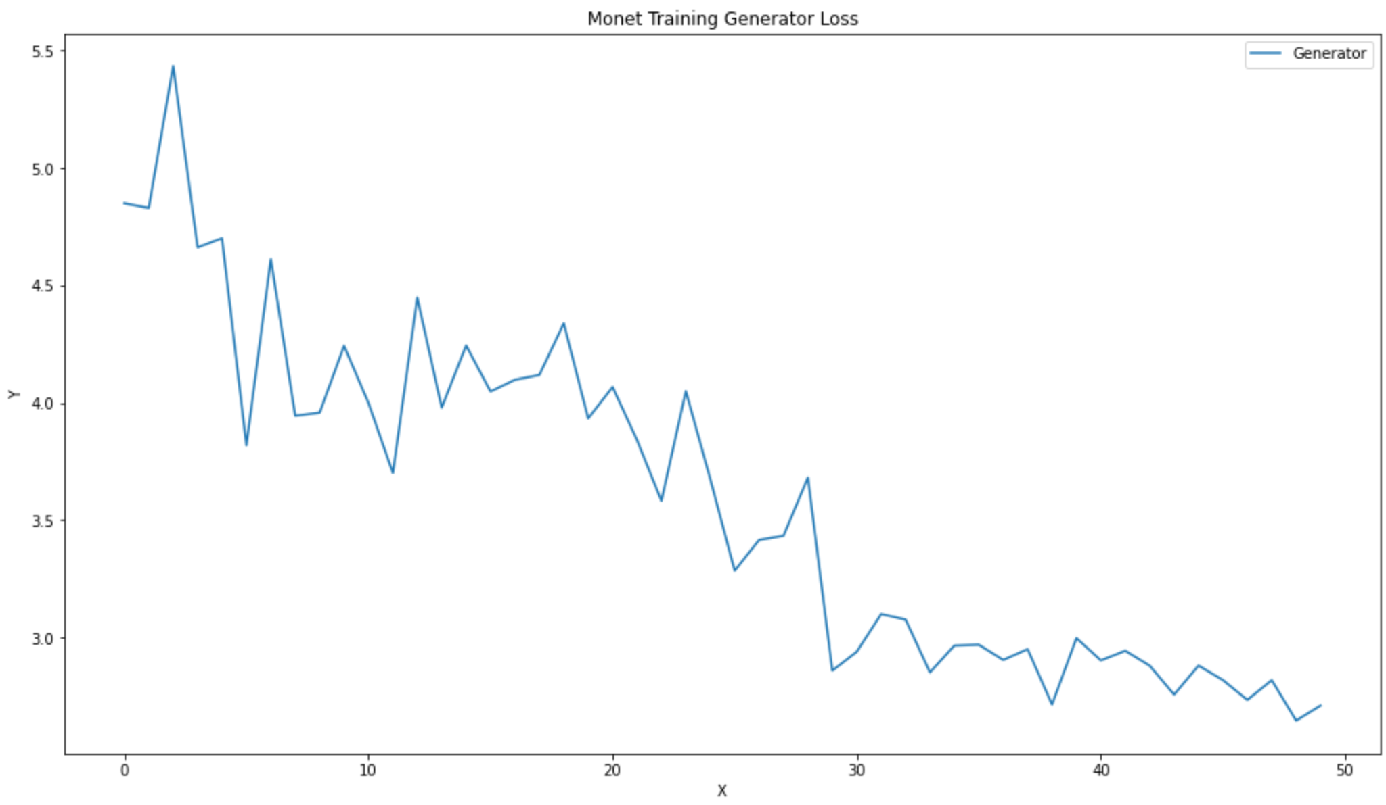
Performance Results
Hyperparameters
Use only ReLU activation function in generator except the output (tanh)
Use leakyReLU in the discriminator
Learning Rate: 0.0002 (both G & D)
Optimizer: Adam (beta_1 = 0.9 & beta_2 = 0.999)
Epochs: 50
Performance & Evaluation
Generator Loss: 4.87 to 2.71 at 50 epochs.
Discriminator Loss: 0.31 after 50 epochs

Slide 35
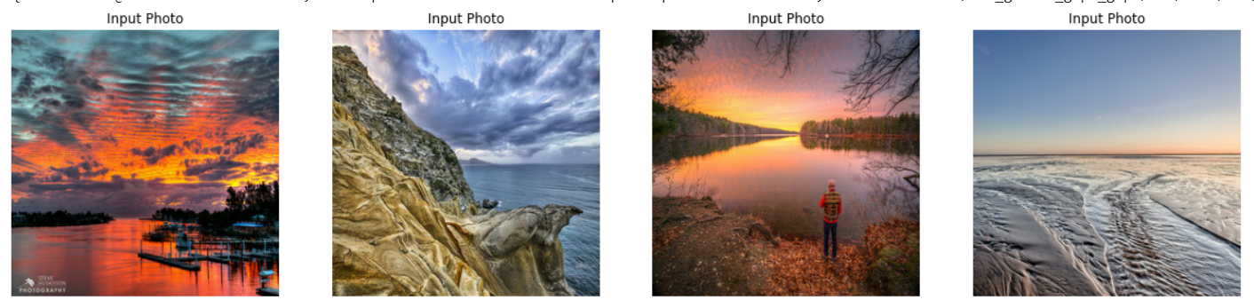
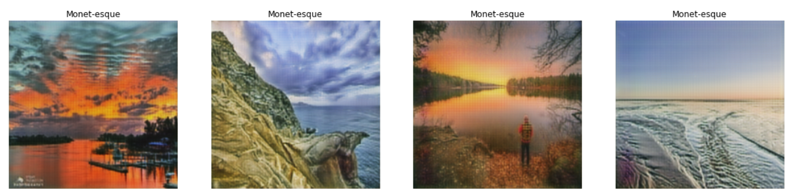
Output Visualizations

Slide 36
Models Justification
To tackle the problem of unpaired image-to-image translations:, all the 4 Models are well suited
Base CycleGAN: Purpose of Cycle GAN is to transfer characteristics of an image to another. It is considered the best known model for image reconstruction. This makes CycleGAN our choice of model for the project as we are performing style transfer of images from photo to monet
Improved CycleGAN: Implemented Cyclegan with improved model architecture using better ways of transformation layers to extract the best features of images and getting the better performance
Pix2Pix based CycleGAN: Pix2pix is a classic and reliable architecture when it comes to paired image-to-image translation. However, we tried to implement this model to see how it would work with unpaired images
DCGAN based CycleGAN: DCGAN has a good performance and does well with complex image reconstruction. That is why we wanted to try to apply DCGAN architecture into a cycleGAN to test how it would perform.

Slide 37
Model Comparison & Result Analysis
Model | G_loss | D_loss | Epoch no. | Time | Resource
Cycle GAN with ReLu | 6.76 | 0.13 | 250 | ~3 hours | GPU P100
Improved Cycle GAN | 1.9 | 0.47 | 200 | ~ 1.5 hours | TPU v3-8
Pix2pix based | 2.60 | 0.26 | 50 | ~ 1.5 hours | TPU v3-8
DCGAN based | 2.71 | 0.31 | 50 | ~ 3 hours | TPU v3-8

Slide 38
Conclusion & Future Work
Conclusión
Based on the statistics mentioned in table , Improved Cycle GAN model (model 2) outperforms all other models
Future Work
This model can be further trained for more epochs using higher computation resources and more images to achieve better model performance
Perform more research on new ways to implement model

Slide 39
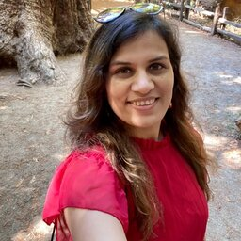
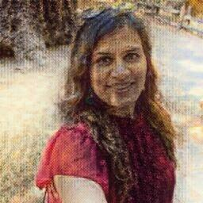
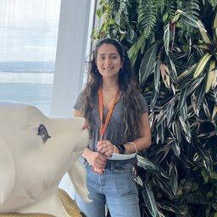
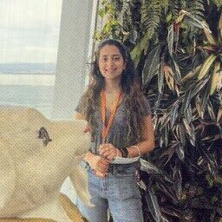
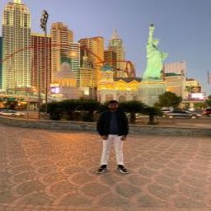
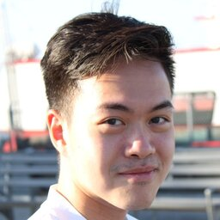
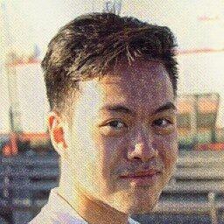
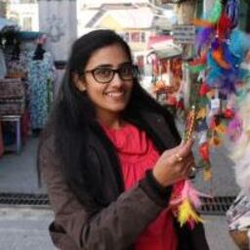
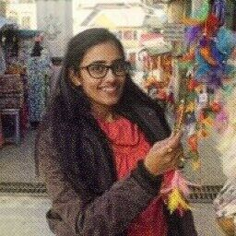
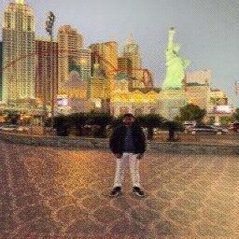
¡The Team Monet!

Slide 40
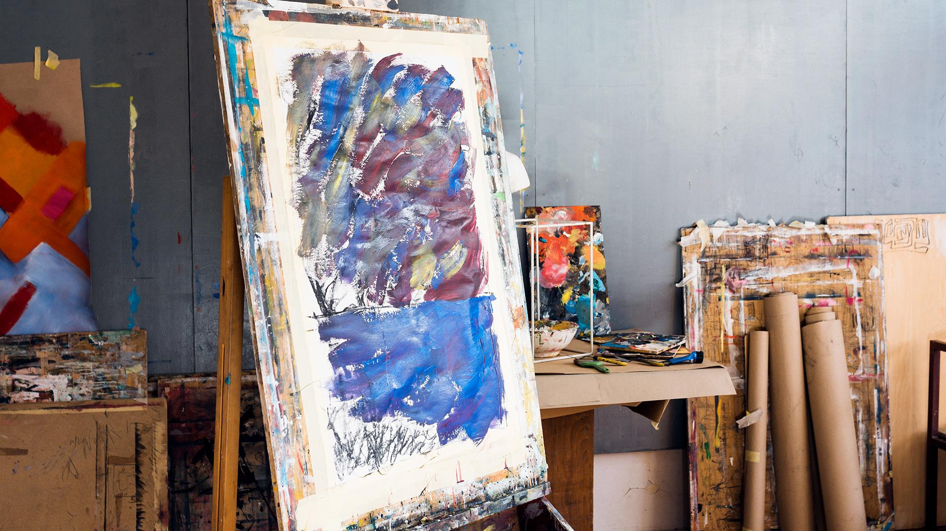
Thank You

Slide 41
References
Improved generative adversarial network and its application in image oil painting style transfer, Image and Vision Computing, Volume 105, 2021, 104087, ISSN 0262-8856, https://doi.org/10.1016/j.imavis.2020.104087.
https://openaccess.thecvf.com/content_CVPR_2019/papers/Qiao_MirrorGAN_Learning_Text-To-Image_Generation_by_Redescription_CVPR_2019_paper.pdf
http://proceedings.mlr.press/v37/gregor15.pdf
https://dl.acm.org/doi/pdf/10.1145/3240508.3241386?casa_token=PP4EhnsVi1oAAAAA:kJpFV_OcFyLJuDzlgGA6Xs4Lfndwf7VpuK7ARFMOECIVlWgx9euGlWfOhsKBg2HAySMaRFPwtTZjRw
H. Meng and F. Guo, "Image Classification and Generation Based on GAN Model," 2021 3rd International Conference on Machine Learning, Big Data and Business Intelligence (MLBDBI), 2021, pp. 180-183, doi: 10.1109/MLBDBI54094.2021.00042.
Y. Liang and H. Yao, "Research on GAN-based Container Code Images Generation Method," 2020 19th International Symposium on Distributed Computing and Applications for Business Engineering and Science (DCABES), 2020, pp. 198-201, doi: 10.1109/DCABES50732.2020.00059.
M. Gong and Y. Wang, "An Feature Image Generation Based on Adversarial Generation Network," 2020 12th International Conference on Measuring Technology and Mechatronics Automation (ICMTMA), 2020, pp. 479-482, doi: 10.1109/ICMTMA50254.2020.00109.
https://jonathan-hui.medium.com/gan-dcgan-deep-convolutional-generative-adversarial-networks-df855c438f

